Slide 1
House Price Prediction by Neural Network Presentation
By 林文淵 博一
學號: 110369007

Slide 2

5.
1.
Data correlation analysis
6.
Read data from .csv
2.
7.
Remove low correlation features
Histplot to exploration of data
3.
Data Normalization
8.
Remove Outliers – “price”
4.
Model Creating –
Hyper parameter adjustment
Remove Outliers – “bedroom”
9.
CONTENTS
TenorBoard
CONTENTS
Notes:
使用方法： 【更改文字】：将标题框及正文框中的文字可直接改为您所需文字 【更改图片】：点中图片》绘图工具》格式》填充》图片》选择您需要展示的图片 【增加减少图片】：直接复制粘贴图片来增加图片数，复制后更改方法见【更改图片】 【更改图片色彩】：点中图片》图片工具》格式》色彩（重新着色）》选择您喜欢的色彩 下载更多模板、视频教程：http://www.mysoeasy.com

Slide 3
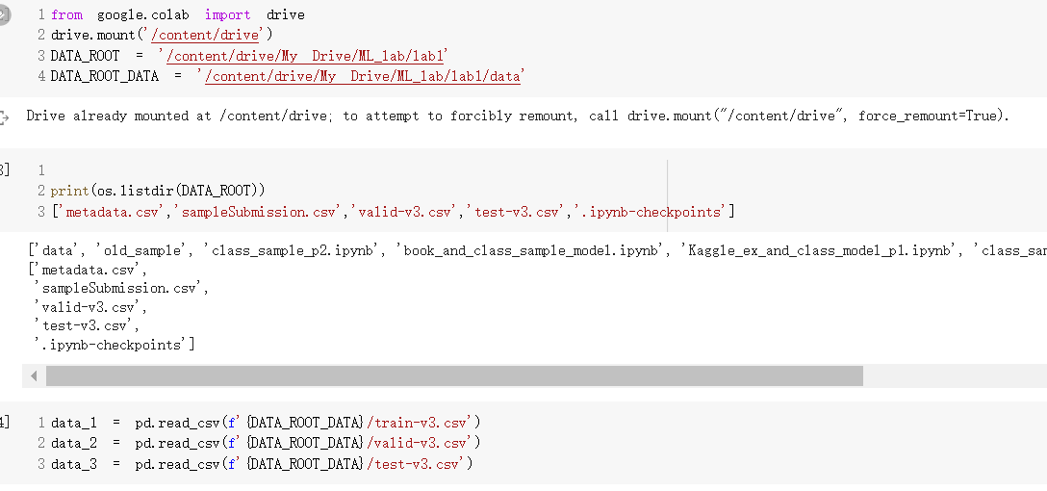
Read data from *.csv

Slide 4
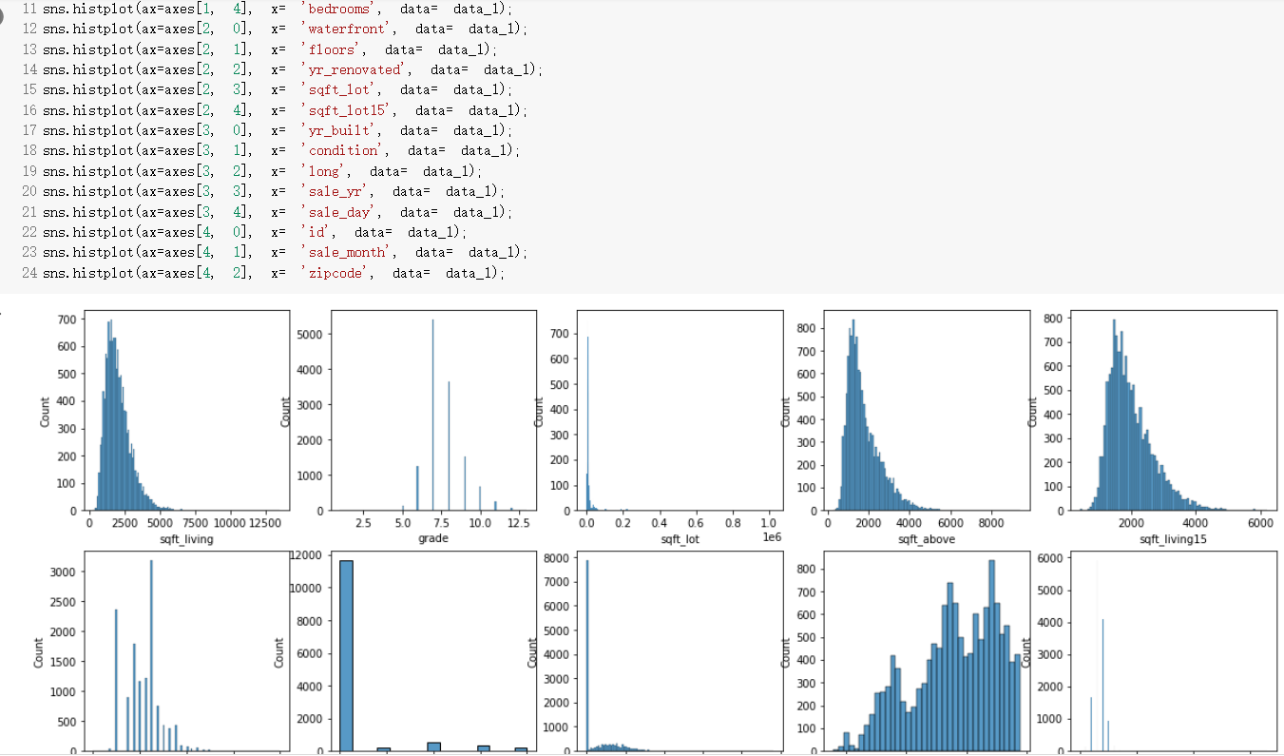
Histplot to exploration of data

Slide 5
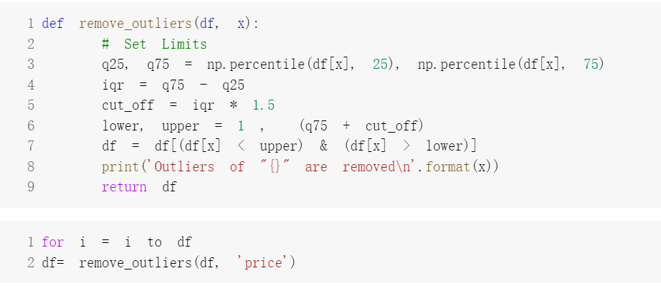
Remove Outliers – “price”

Slide 6
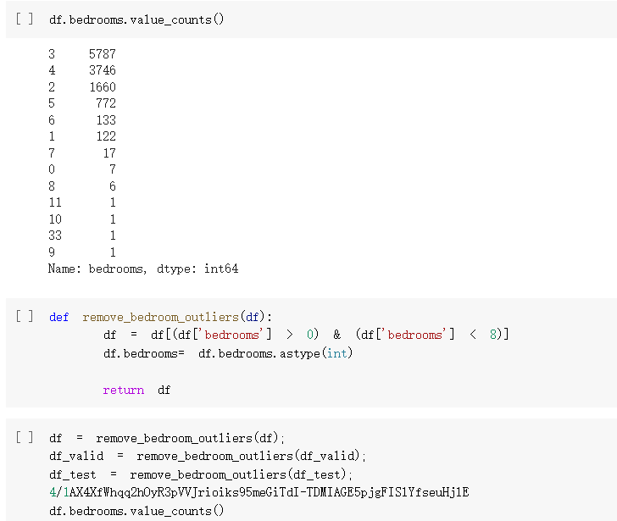
Remove Outliers – “bedroom”

Slide 7
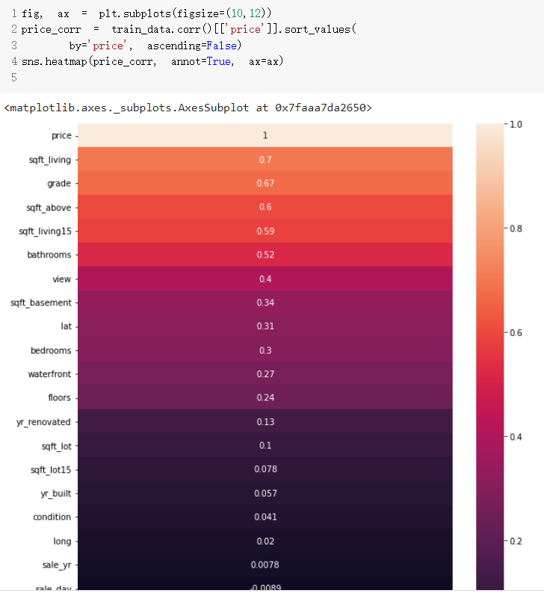
Data correlation analysis

Slide 8
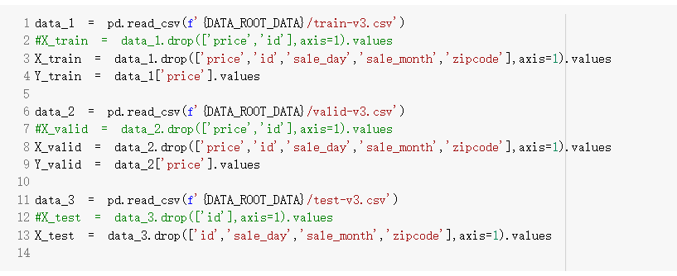
Remove low correlation features

Slide 9
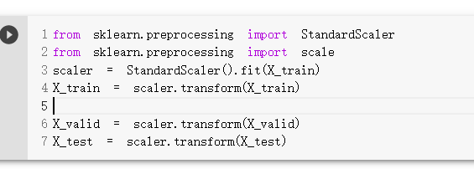
Data Normalization

Slide 10
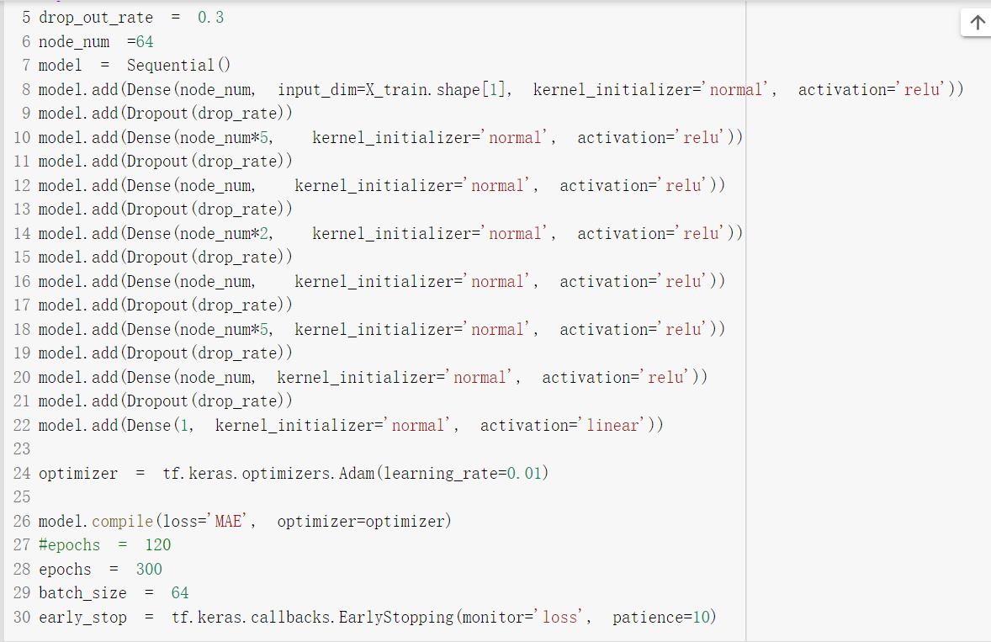
Model Creation – Hyper Parameters Adjustment
Optimization factor
Layer number
Node number for each layer.
Loss function
Batch Size
Epoch
Metrics
5. Weight Normalization
DropOut
Learning Rate
Adaptive
Early Stop
Activation

Slide 11
